Slide 1
Welcome Parents
Sign up for a conference.
Watch the Eagle Alliance Video.

Slide 2

Back To School Night
Kindergarten
Back to School Night
Adler’ s Class

Slide 3
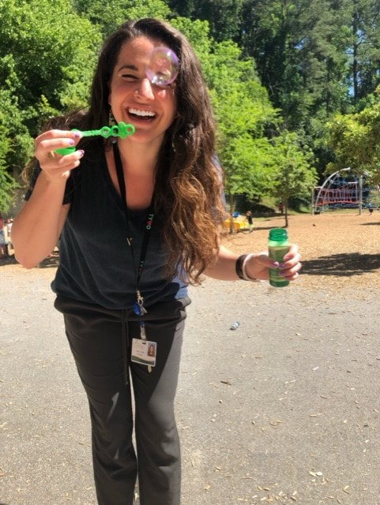
Who I am…
.
This is my 6th year at HFE. I have taught first grade for two years and kindergarten all the others. At the University of Georgia, I got my degree in Early Childhood Education and stayed on to get my Master’s in Children’s Language and Literature and received my Gifted Education Endorsement. My husband and I live in Old Fourth Ward across from Ponce City Market.

Slide 4
Personal Mission
As an educator I am passionate about supporting the growth and education of all my students.
I believe that all students are important individuals capable of learning.
I want your children to love learning and be excited to come to school everyday

Slide 5

Heards Ferry Mission and Vison

Slide 6
School Information
7:10-7:40 Homeroom/Arrival
7:40 a.m. School Begins/Tardy Bell (Students must be in classroom by 7:40 to not be considered tardy)
2:15 p.m. Afternoon announcements
2:20 p.m. Dismissal Begins
Early Checkouts before 2:00
Breakfast at school is available until 7:35
Changes in Dismissal must have a written note
- See website for transportation form

Slide 7
Attendance
School hours are from 7:40-2:20.
It is important that students are here on time every day.
Team Time will be first thing in the morning (re-teaching/enrichment)
If your child is absent, please send in a written note or doctor’s note for an excused absence.

Slide 8
7:10-7:40- Morning Work
7:40-7:45- Announcements/ Attendance
7:50-8:15- SOAR Lessons/Team Time
8:15-9:00- Specials
Monday- PE with Coach K
Tuesday- Music with Wallace
Wednesday- Art with Strom
Thursday- No specials
Friday- PE with Coach K
9:00-10:10-Math Inquiry
9:00-9:15- Calendar Math/Morning Meeting
9:15-9:25- Math Mini-Lesson, Small groups, Independent Centers
10:10-10:20- Shared Reading/Get Ready for Lunch (bathroom/wash hands)
10:25-10:55- Lunch (Table 11)
11:05-11:35-Recess
11:35-1:35 ELA Inquiry
11:35-11:50-Word Work
11:50-12:00-Read Aloud
12:05-12:45- Writing Workshop
12:45-1:35- Reading Workshop
1:35-2:10-Science/Social Studies Inquiry/Working Snack
2:10-2:20-Pack Up
2:20-Dismissal

Slide 9
Communication
Why they are so important ……..
Yellow Folder-returned every day
change of transportation
Blue Folder Thursday-
Monthly Newsletters
Weekly Progress Reports
School information/important documents
Weebly
Classroom Information
Email
Weekly/Monthly update
Notes:
to be used for daily communication (ex: transportation changes and absence notes). Please make sure to check and send the folder to school every day.

Slide 10
Weebly
Weebly is our school’s way of parent/teacher/classroom
communication.
-Our class Weebly page is one of the ways to stay up
to date with what’s happening in the classroom.
My Weebly page is located at:
https://kurlandkindergarten.weebly.com/
On the website, you can find:
*Class Pictures
*Schedule
*Current Standards
*Important Dates
AND MORE!!!!

Slide 11

Heards Ferry Eagle Alliance Website
This site is located at https://hfeeaglealliance.membershiptoolkit.com/
On the Eagle Alliance site you can:
View upcoming events
Access links (i.e. change of dismissal forms, school information)
Sign up for volunteer opportunities (i.e. field day, STEM day, etc.)

Slide 12
School Wide Behavior
Positive
Behavior
Interventions &
Support
*School wide positive reinforcements like crazy sock day.
*Eagle Points- Yellow copy/White copy
*School Wide Discipline Cycle (Reflection Sheets- 3 is an office referral)
*Team Spirit Day

Slide 13
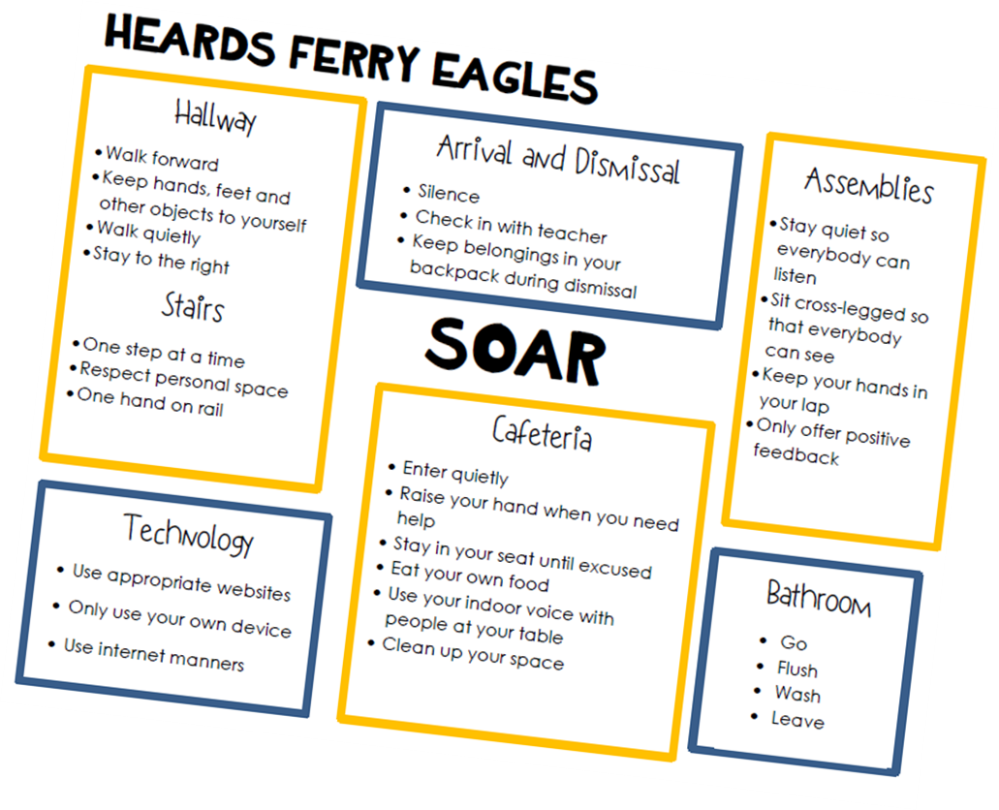
School Wide Behavior Matrix
S:Safe
O:Outstanding
A:Accountable
R:Respectful

Slide 14

Units of Study
Georgia Standards of Excellence for math, reading, and language arts, science and social studies.
Science:
Earth Science – day and night sky
Sorts rocks and soils
Physical Science – 5 senses
Composition of materials
Motion
Life Science – Living/Nonliving
Animals/Plants
Parents/Offspring
Habits of Mind - ask questions
Use numbers to quantify
Use tools to measure and view
Look at parts of things
Describe and compare using physical
attributes
Observe using their senses and
describe observation
Social Studies:
Holidays
American Symbols
Maps and Globes
Community Helpers

Slide 15
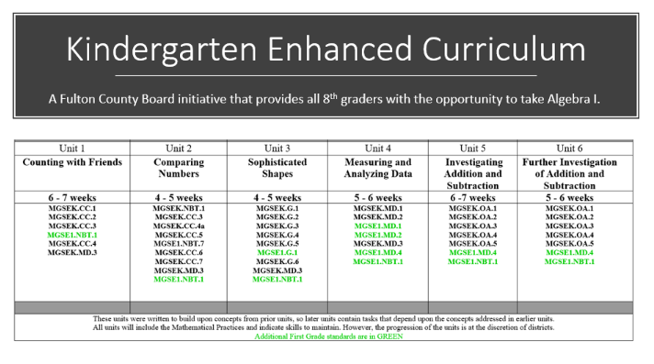

Slide 16
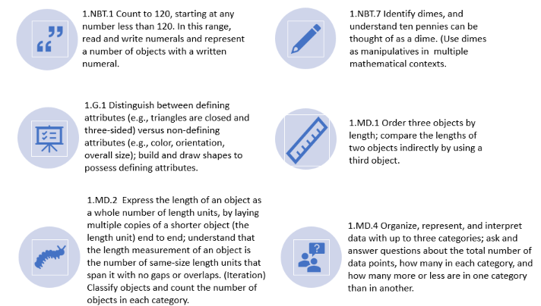

Slide 17
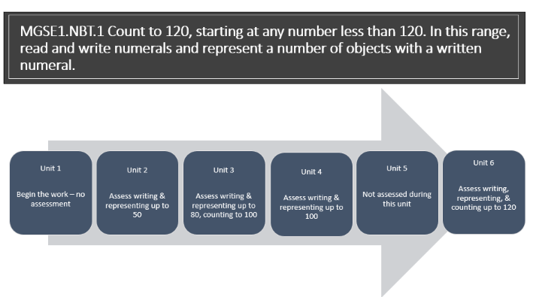

Slide 18
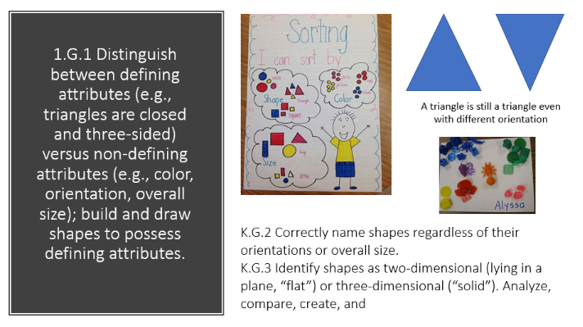

Slide 19
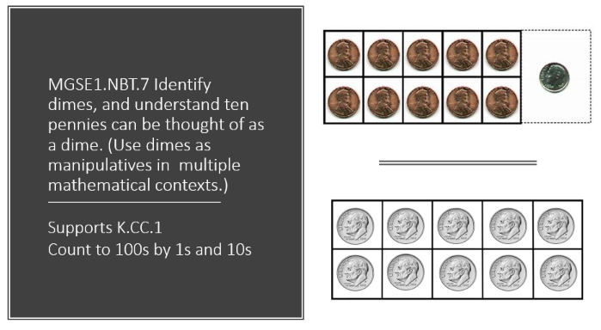

Slide 20
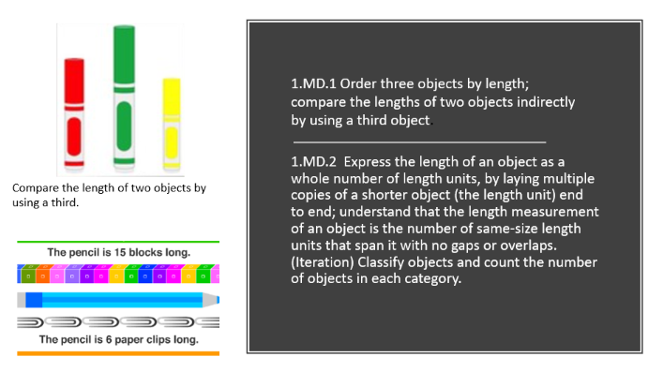

Slide 21
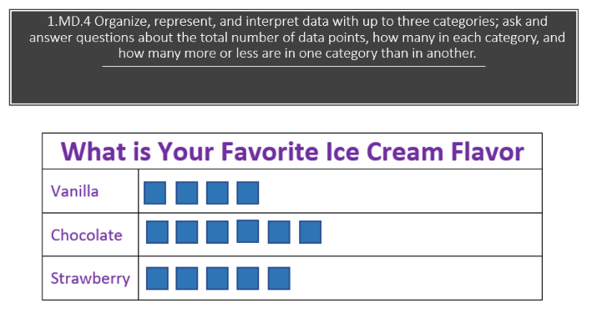

Slide 22
How your child will succeed at their learning level..
In reading and math
3 small groups in each subject
Allows for differentiation using data.
Students will visit me, Mrs. Brannon and independent workstation which are also tailored your child’s learning level
Iread and iready math

Slide 23
Balanced Literacy
Balanced literacy is a comprehensive program within reading and has different components.
Modeled (Extended Text)-Read Aloud
Shared Reading-Students can see and interact with text
Guided Reading/Skill based groups
Takes place in small groups
Students read at instructional reading level
Independent Reading
Students read at independent reading level

Slide 24
Why readers and writers workshop ..
“…students become powerful readers and writers who read and write for real reasons - to advocate for themselves and others, to deepen their own and others’ knowledge, to illuminate the lives they live and the world they are a part of.”
Our work aims to prepare kids for any reading and writing task they will face or set themselves, to turn them into life-long, confident readers and writers who display agency and independence in their future endeavors.
The Reading & Writing Project
Teacher’s College, Columbia University

Slide 25
What is readers workshop???
Reader’s workshop is a literature-based program where students read and respond to meaningful text while focusing on a reading skill. Students get to choose what they read and how they implement the skill.
What does it look like ?
I deliver a short mini-lesson on a comprehension skill. Then, students practice the skill during independent reading time. They focus on the skill while reading and responding to their text to help them make a connection with the concept taught.

Slide 26
What is Writers' workshop??
Writer’s workshop is an environment where students can acquire the skills and confidence to see themselves as writers. Student’s are put in charge and are actively involved in creating their own texts. The writing workshop puts students on the spot and makes them responsible for their writing.
What does it look like ….
I deliver instruction on a specific writing technique during a brief mini-lesson. Then, students practice the technique during independent writing time. We write every day and students determine the subject they write about within the genre’s.

Slide 27

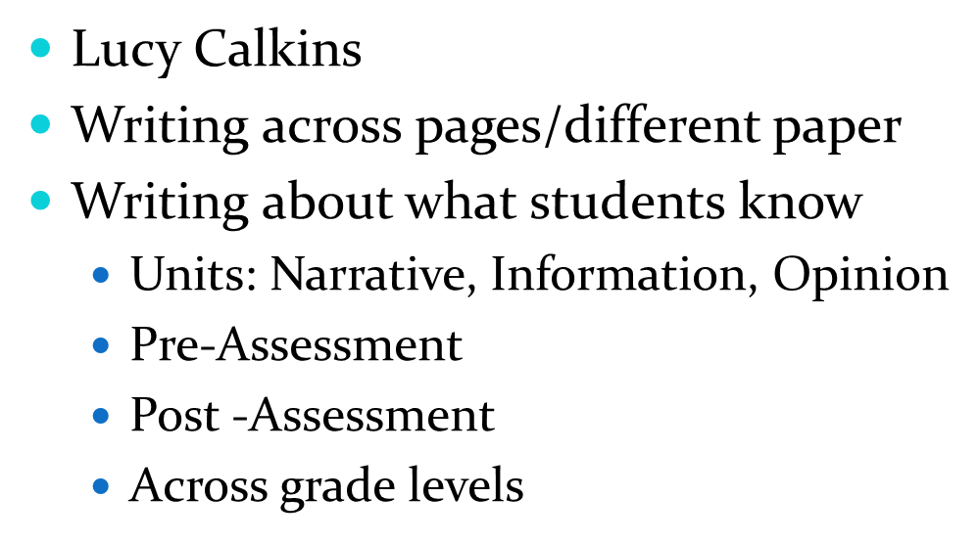

Slide 29


Online Resources
Web-based programs that will be available for Kindergarten (access via Classlink- Formerly Launchpad)
Iread-
Iready Math-

Slide 30
Grades
Infinite campus parent portal
Provides access to information for all enrolled students in their household. Information includes grades, attendance, assignments, and school announcements.
-Handbook pg. 13:
S- 100-80
N- 79-70
U- 70 and below
Formative- 60%
Summative-30%
Homework – 10%
Report Cards -4 times a year ( October, January, March , May)

Slide 31
Fluency Assessment
Fontas and Pinnell Benchmark Assessment System (BAS).
Given 3 times a year
This determines their reading level on a scale from A-Z.
Independent and Instructional levels
Students should leave kindergarten reading on a level D instructional level and level C independent reading level.

Slide 32
Math Unit Assessments
Before each math unit, we pre-assess students to inform our instruction in small groups and independent learning centers.
After each math unit, we will assess students to see if they have mastered all standards.

Slide 33
Grades…
Infinite campus parent portal
Provides access to information for all enrolled students in their household. Information includes grades, attendance, assignments, and school announcements.
0=Unsatisfactory (U) 69% and below
1=Needs Improvement (N) 70%-79%
2=Satisfactory(S) 80%-100%
Report Cards- 4 times a year (October, January, March, May)

Slide 34
GKIDS
GKIDS is the Georgia Kindergarten Inventory of Developing Skills. Your child will have ongoing formative assessments through the use of GKIDS and instruction will be enriched or reinforced. Groupings are flexible and will be based on student need.
Scores are reported as:
ND- Not demonstrated
EM- Emerging
PR- Progressing
ME- Meets
EX- Exceeds

Slide 35
Progress Skills Checklist
Go home at the end of October, February and May.
Standards based
Tell what standards students may still be working on or have mastered.

Slide 36

Digital Citizenship
Heards Ferry’s vision is to empower ALL students to behave safely and participate responsibly with technology.
Students will use their device for educational purposes only and be sure to be safe and appropriate while online.
They will listen to their head and heart and protect private information and respect themselves and others while online.
Lastly, they will stand up and say NO to cyberbullying!

Slide 37
IB
Active, Caring, Lifelong Learners
Inquiry
Respectful to themselves and others
Wonder Board
IB Wall
Transdisciplinary Theme
Central Idea
Lines of Inquiry
Key Concepts
Attitudes
Learner Profiles
Transdisciplinary Skills
Related Concepts

Slide 38
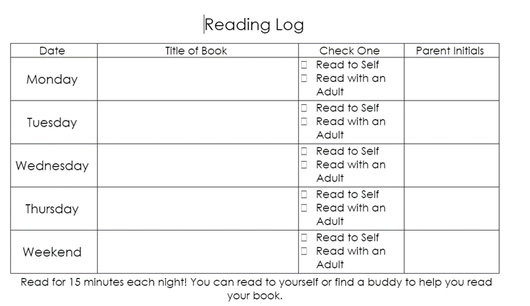
Homework
Your child will read 15 minutes every night.
Initial every night- Sheet due on Monday’s (Due on Tuesday’s if there is no school on Monday)
Weekend- choose at least one: Friday, Saturday, or Sunday

Slide 39
Eagle Alliance & Volunteers
Please join EA and register for volunteer opportunities on the website.
Volunteer schedule TBA
Must complete online volunteer training before working in the classroom.

Slide 40
Friendly Reminders
Bring a snack daily (or week’s worth in a Ziploc)
When you come for Mystery reader you will bring a book and an activity that goes along with the book . You may also bring in a treat.
Please work on tying shoes.

Slide 41
Birthdays
Birthday Policy
No birthday cakes, balloons, candles, videotaping or singing please.
Please check with the teacher regarding food allergies prior to bringing in a treat.
Notes:
Birthday parties for individual children will not be held at school. Each teacher has their own way of recognizing these special days. Parents may send in store bought, individually wrapped treats to be shared with students at lunchtime

Slide 42
Questions, Comments, Concerns?
School phone: 470-254-6190
E-mail:
adleri@fultonschools.org

