Slide 1
Welcome to Curriculum Night
Mrs. Adler and Mrs. Brannon

Slide 2
Mission Statement:
To develop self-motivating, globally minded thinkers through inquiry and reflection.

Slide 3
Communication:
+ Email
+ Class Weebly
(kurlandkindergarten.weebly.com)

Slide 4
Url schedule

Slide 5
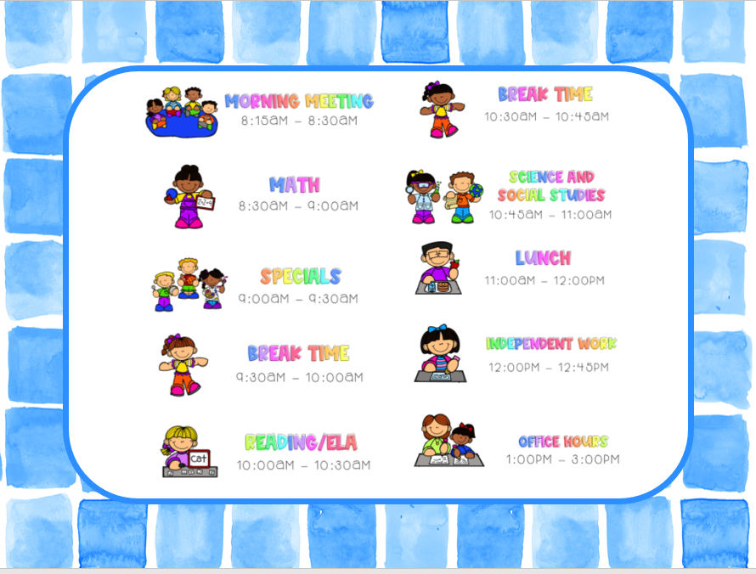

Slide 6
Attendance:
Grades K-1 – Participation: One of the following must be met each WEEK to mark a student’s daily attendance for the week:
​
+ Submission of weekly work packet or ​
+ Direct contact with parent/guardian that is
logged or ​
+ Participation in a synchronous lesson ​

Slide 7
SOAR + PBIS
+ Eagle Points
+ Fun Friday SOAR hat
+ Shout-outs
+ Student of the Week
+ Virtual Pep Rallies
+ Clip Chart
​

Slide 8
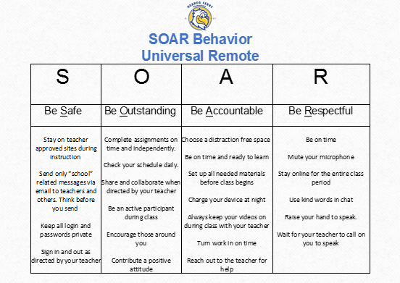

Slide 9
Grading Policy
Per GADOE guidance, FCS and HFE has adopted a NO ZERO policy during Universal Remote Learning. ​
+ An ‘I’ will be entered in Infinite Campus for missing assignments and assessments.​
+ At the end of a grading period an ’I’ for incomplete will be entered on a student’s report card if a student does not complete 80% of the summative assignments/ assessments​.
+ Students will have the remainder of the school year to complete the missing work. ​

Slide 10
Grading Feedback
+ Report cards will go home twice a year (end of each
semester).
+ Grades are cumulative BY SEMESTER.
+ The final semester grade will be derived from the
average of all summative assignments.
+ A progress report will go home at the 1st and 3rd 9
weeks to report progress only.​
+ Students will receive feedback within 48 hours of
work submission.

Slide 11
Grading scale
The following grading scale will be utilized if 50% of the marking period is spent in remote learning.​
​
Grades K-2:​
S – Satisfactory (Assignments numerical average of 80% or higher)​
N – Needs Improvement (Assignments numerical average of 70% – 79%)​
I – Incomplete (less than 80% of graded assignments were completed OR assignments average less than 70%)​
If graded assignments average less than 70%, students should be given opportunity to redo/resubmit assignments​
NG – No grade (enrolled less than 20 days)​

Slide 12
Grading scale
Grade Weights
Formative 0%
Summative- 100%
Continuous Achievement​
For Grade K and Grade 1 First Semester: There is no advanced RELA. ​
For Grades 2-5 (and 1st Grade 2nd Semester) in RELA students are either on-level, advanced, or accelerated. ​
For Grades K-5 in Math, student placement is semester-based.​
Conduct ​
No conduct grades reported.

Slide 13
Grading scale
Instructional Platform
Microsoft Teams
Modes of Instruction
Synchronous (LIVE and will be recorded)
Whole Group Instruction
Whole Group Discussion
Small Group/Guided Reading Instruction
Conferences
Asynchronous (ON-DEMAND)
iReady
Pre-Recorded Video
Brain Pop
Etc…*

Slide 14
Math Instruction
+ Georgia Standards of Excellence
+ Small Group Instruction (Based on Data)
+ Continuous Achievement Levels
+ Instructional Resources
- iReady Math

Slide 15
Ela Instruction
+ Georgia Standards of Excellence
+ Lucy Calkins Reading and Writing Units
of study
+ Phonics
+ Small Group Instruction (Based on Data)
+ One on one conferencing
+ Continuous Achievement

Slide 16
Why Readers and Writers Workshop?
“…students become powerful readers and writers who read and write for real reasons - to advocate for themselves and others, to deepen their own and others’ knowledge, to illuminate the lives they live and the world they are a part of.”
Our work aims to prepare kids for any reading and writing task they will face or set themselves, to turn them into life-long, confident readers and writers who display agency and independence in their future endeavors.
The Reading & Writing Project
Teacher’s College, Columbia University

Slide 17
What is a reader’s workshop and what does it look like?
Reader’s workshop is a literature-based program where students read and respond to meaningful text while focusing on a reading skill. Students choose what they read as they implement the skill.
The teacher delivers a short mini-lesson on a comprehension skill; then students practice the skill during independent reading time. Students focus on the skill while reading and responding to the text to help them make a connection with the concept being taught.

Slide 18
International Baccalaureate
The IB Primary Years Program prepares students to become active, caring, lifelong learners who demonstrate respect for themselves and others and have the capacity to participate in the world around them. It focuses on the development of the whole child.

Slide 19
International Baccalaureate
+ 6 transdisciplinary themes
+ Learner Profile
+ IB Attitudes
+ Spanish for 1st –5th
+ Cookies for Character
+ International Inquirer
+ Service Projects

Slide 20
International Baccalaureate
Inquiry Units:
1. How the World Works
2. How We Express Ourselves
3. How we Organize Ourselves
4. Where We Are in Place and Time
5. Sharing the Planet
6. Who We Are

Slide 21
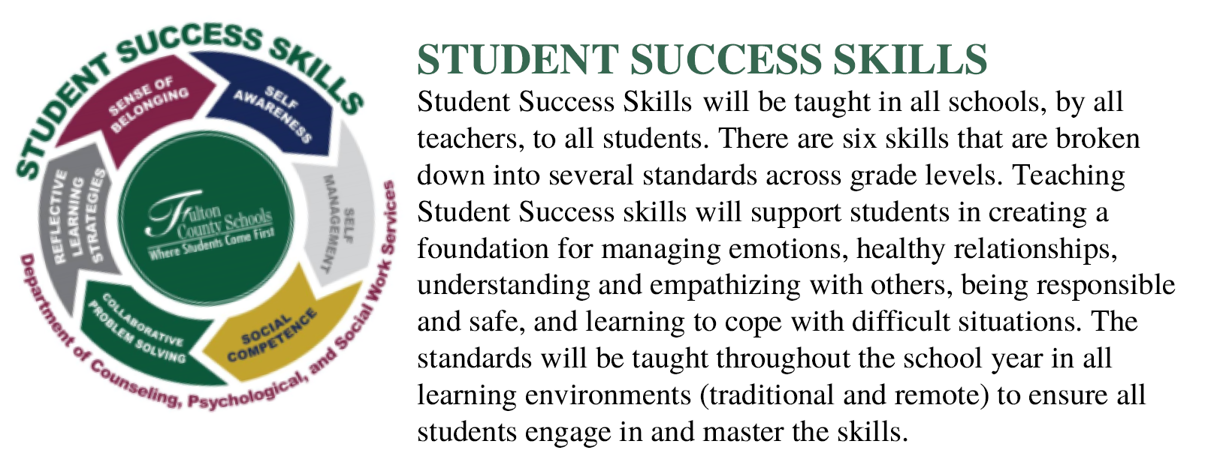
Student Success Skills Curriculum

Slide 22
Assessing your Child
+ End of Unit Assessments
+ Performance Tasks
+ Quizzes
+ Class Assignments
+ Group Discussion
+ iReady Universal Screener
Fall, Winter, Spring

Slide 23
Digital Platforms
+ Microsoft Teams
+ Seesaw
+ Classlink
+ iReady
+ Epic! Books
+ RAZ Kids

Slide 24
Digital Citizenship
Heards Ferry’s vision is to empower ALL students to behave safely and participate responsibly with technology.
Students will use their device for educational purposes only and be sure to be safe and appropriate while online.
They will listen to their head and heart and protect private information and respect themselves and others while online.
Lastly, they will stand up and say NO to cyberbullying!

Slide 25
Questions

Slide 26
Thank you!

